Slide 1
VAPOR AND COMBINED POWER CYCLES

Slide 2
In previous Chapter, we discussed gas power cycles for which the working fluid remains a gas throughout the entire cycle.
In this chapter, we consider vapor power cycles in which the working fluid is alternatively vaporized and condensed.
Steam is the most common working fluid used in vapor power cycles because of its many desirable characteristics, such as low cost, availability, and high enthalpy of vaporization.
Steam power plants are commonly referred to as coal plants, nuclear plants, or natural gas plants, depending on the type of fuel used to supply heat to the steam.
However, the steam goes through the same basic cycle in all of them.
Throughout the discussions, we assume steam to be the working fluid since it is the working fluid predominantly used in vapor power cycles
Notes:
A gas refers to a substance that has a single defined thermodynamic state at room temperature whereas a vapor refers to a substance that is a mixture of two phases at room temperature, namely gaseous and liquid phase.

Slide 3
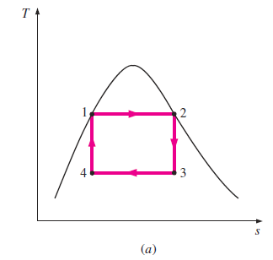

THE CARNOT VAPOR CYCLE
Consider a steady-flow Carnot cycle executed within the saturation dome of a pure substance, as shown in Fig. 10-1a.
The fluid is heated reversibly and isothermally in a boiler (process 1-2),
Expanded isentropically in a turbine (process 2-3),
Condensed reversibly and isothermally in a condenser (process 3-4),
and compressed isentropically by a compressor to the initial state (process 4-1)

Slide 4
Several impracticalities (unrealistic) are associated with this cycle:
Isothermal heat transfer to or from a two-phase system is not difficult to achieve in practice since maintaining a constant pressure in the device automatically fixes the temperature at the saturation value.
Therefore, processes 1-2 and 3-4 can be approached closely in actual boilers and condensers.
Limiting the heat transfer processes to two-phase systems, however, severely limits the maximum temperature that can be used in the cycle (it must remain under the critical-point value, which is 374°C for water).
Limiting the maximum temperature in the cycle also limits the thermal efficiency.
Any attempt to raise the maximum temperature in the cycle involves heat transfer to the working fluid in a single phase, which is not easy to accomplish isothermally.

Slide 5
The isentropic expansion process (process 2-3) can be approximated closely by a well-designed turbine.
However, the quality of the steam decreases during this process, as shown on the T-s diagram in Fig. 10–1a.
Thus the turbine has to handle steam with low quality, that is, steam with a high moisture content.
The collision of liquid droplets on the turbine blades causes erosion and is a major source of wear.
Thus steam with qualities less than about 90 percent cannot be tolerated in the operation of power plants.

Slide 6
The isentropic compression process (process 4-1) involves the compression of a liquid–vapor mixture to a saturated liquid.
There are two difficulties associated with this process.
First, it is not easy to control the condensation process so precisely as to end up with the desired quality at state 4.
Second, it is not practical to design a compressor that handles two phases.

Slide 7
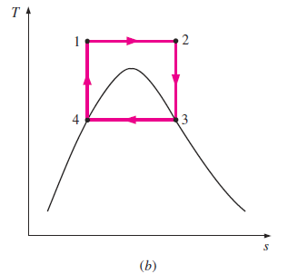
Some of these problems could be eliminated by executing the Carnot cycle in a different way, as shown in Fig. 10–1b.
This cycle, however, presents other problems such as isentropic compression to extremely high pressures and isothermal heat transfer at variable pressures.
Thus we conclude that the Carnot cycle cannot be approximated in actual devices and is not a realistic model for vapor power cycles.

Slide 8
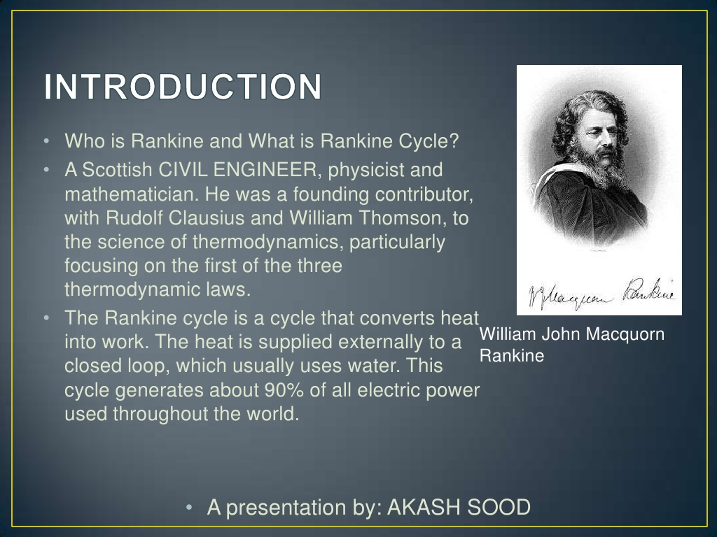
RANKINE CYCLE

Slide 9
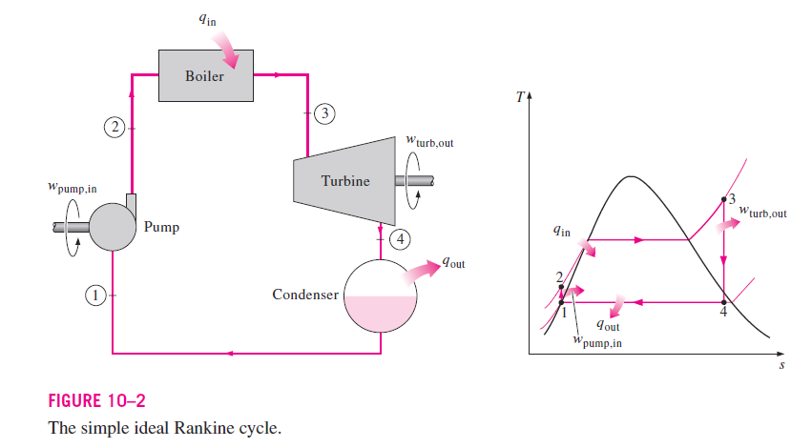
RANKINE CYCLE: THE IDEAL CYCLE FOR VAPOR POWER CYCLES
Many of the impracticalities associated with the Carnot cycle can be eliminated by superheating the steam in the boiler and condensing it completely in the condenser, as shown schematically on a T-s diagram in Fig. 10–2.

Slide 10
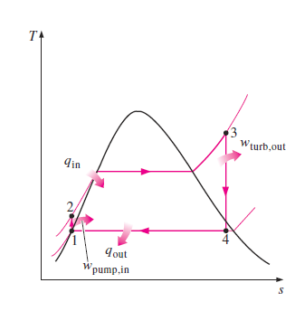
Rankine cycle is the ideal cycle for vapor power plants.
The ideal Rankine cycle does not involve any internal irreversibilities and consists of the following four processes:
1-2 Isentropic compression in a pump
2-3 Constant pressure heat addition in a boiler
3-4 Isentropic expansion in a turbine
4-1 Constant pressure heat rejection in a condenser

Slide 11
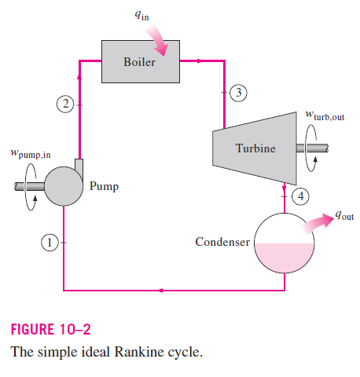
Water enters the pump at state 1 as saturated liquid and is compressed isentropically to the operating pressure of the boiler.
The water temperature increases somewhat during this isentropic compression process due to a slight decrease in the specific volume of water.
The vertical distance between states 1 and 2 on the T-s diagram is greatly exaggerated for clarity.

Slide 12
Water enters the boiler as a compressed liquid at state 2 and leaves as a superheated vapor at state 3.
The boiler is basically a large heat exchanger where the heat originating from combustion gases, nuclear reactors, or other sources is transferred to the water essentially at constant pressure.
The boiler, together with the section where the steam is superheated (the superheater), is often called the steam generator.

Slide 13
The superheated vapor at state 3 enters the turbine, where it expands isentropically and produces work by rotating the shaft connected to an electric generator.
The pressure and the temperature of steam drop during this process to the values at state 4, where steam enters the condenser.
At this state, steam is usually a saturated liquid–vapor mixture with a high quality.
Steam is condensed at constant pressure in the condenser, which is basically a large heat exchanger, by rejecting heat to a cooling medium such as a lake, a river, or the atmosphere.
Steam leaves the condenser as saturated liquid and enters the pump, completing the cycle.

Slide 14
In areas where water is precious, the power plants are cooled by air instead of water.
This method of cooling, which is also used in car engines, is called dry cooling.
Several power plants in the world, including some in the United States, use dry cooling to conserve water.
Remembering that the area under the process curve on a T-s diagram represents the heat transfer for internally reversible processes, we see that the area under process curve 2-3 represents the heat transferred to the water in the boiler
and the area under the process curve 4-1 represents the heat rejected in the condenser.
The difference between these two (the area enclosed by the cycle curve) is the net work produced during the cycle.

Slide 15

Energy Analysis of the Ideal Rankine Cycle
All four components associated with the Rankine cycle (the pump, boiler, turbine, and condenser) are steady-flow devices, and thus all four processes that make up the Rankine cycle can be analyzed as steady-flow processes.
The kinetic and potential energy changes of the steam are usually small relative to the work and heat transfer terms and are therefore usually neglected.
Then the steady-flow energy equation per unit mass of steam reduces to:

Slide 16
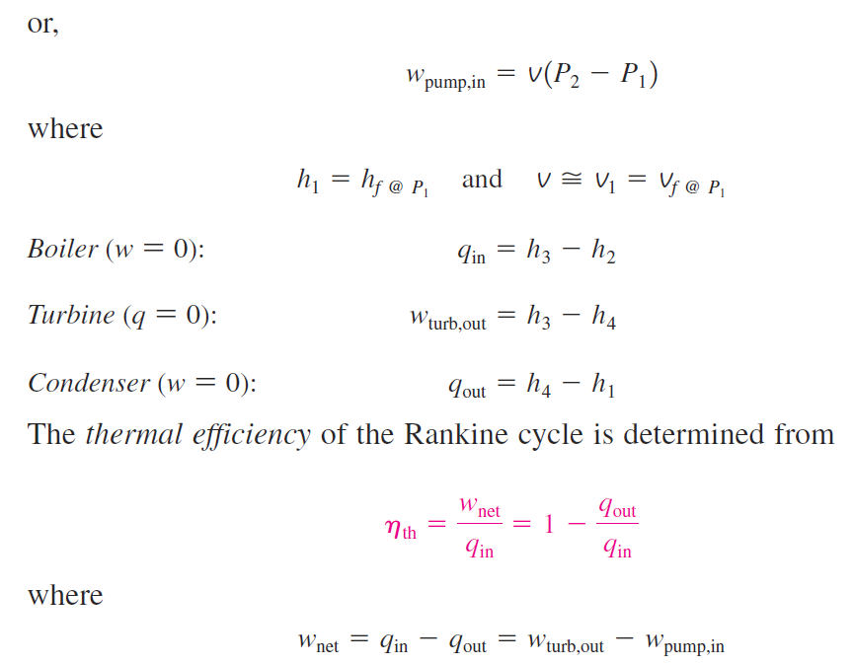
The boiler and the condenser do not involve any work, and the pump and the turbine are assumed to be isentropic.
Then the conservation of energy relation for each device can be expressed as follows:

Slide 17
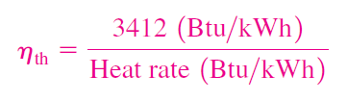
The conversion efficiency of power plants in the United States is often expressed in terms of heat rate, which is the amount of heat supplied, in Btu’s, to generate 1 kWh of electricity.
The smaller the heat rate, the greater the efficiency.
Considering that 1 kWh = 3412 Btu, the relation between the heat rate and the thermal efficiency can be expressed as:
The thermal efficiency can also be interpreted as the ratio of the area enclosed by the cycle on a T-s diagram to the area under the heat-addition process.

Slide 18
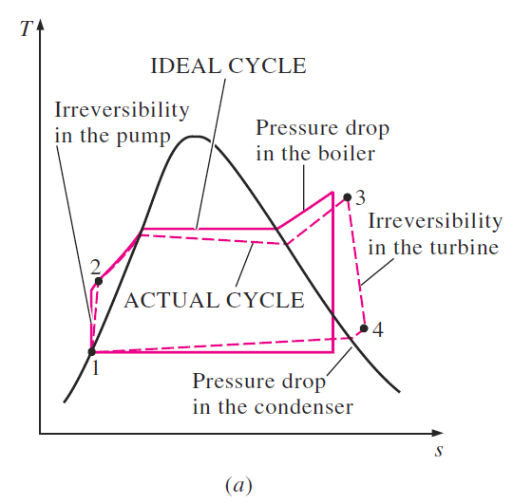
DEVIATION OF ACTUAL VAPOR POWER CYCLES FROM IDEALIZED ONES
The actual vapor power cycle differs from the ideal Rankine cycle, as illustrated in Fig. 10–4a, as a result of irreversibilities in various components.
Fluid friction and heat loss to the surroundings are the two common sources of irreversibilities.

Slide 19
Fluid friction
Fluid friction causes pressure drops in the boiler, the condenser, and the piping between various components.
As a result, steam leaves the boiler at a somewhat lower pressure.
Also, the pressure at the turbine inlet is somewhat lower than that at the boiler exit due to the pressure drop in the connecting pipes.
To compensate for these pressure drops, the water must be pumped to a sufficiently higher pressure than the ideal cycle calls for.
This requires a larger pump and larger work input to the pump.

Slide 20
Heat loss
The other major source of irreversibility is the heat loss from the steam to the surroundings as the steam flows through various components.
As a result, cycle efficiency decreases.
To maintain the same level of net work output, more heat needs to be transferred to the steam in the boiler to compensate for these undesired heat losses.

Slide 21
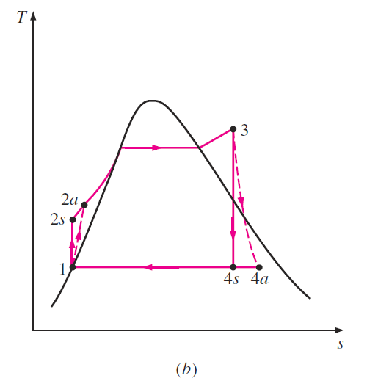
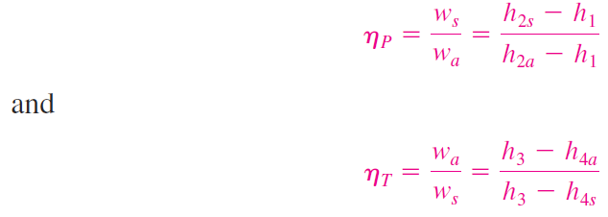
Of particular importance are the irreversibilities occurring within the pump and the turbine.
A pump requires a greater work input, and a turbine produces a smaller work output as a result of irreversibilities.
Under ideal conditions, the flow through these devices is isentropic.
The deviation of actual pumps and turbines from the isentropic ones can be accounted for by utilizing isentropic efficiencies, defined as
The effect of pump and turbine irreversibilities on
the ideal Rankine cycle.

Slide 22
where states 2a and 4a are the actual exit states of the pump and the turbine, respectively, and 2s and 4s are the corresponding states for the isentropic case (Fig. 10–4b).
The effect of pump and turbine irreversibilities on
the ideal Rankine cycle.

Slide 23
HOW CAN WE INCREASE THE EFFICIENCY OF THE RANKINE CYCLE?
Steam power plants are responsible for the production of most electric power in the world, and even small increases in thermal efficiency can mean large savings from the fuel requirements.
Therefore, every effort is made to improve the efficiency of the cycle on which steam power plants operate.
The basic idea behind all the modifications to increase the thermal efficiency of a power cycle is the same:
Increase the average temperature at which heat is transferred to the working fluid in the boiler,
or
decrease the average temperature at which heat is rejected from the working fluid in the condenser.
That is, the average fluid temperature should be as high as possible during heat addition and as low as possible during heat rejection.

Slide 24
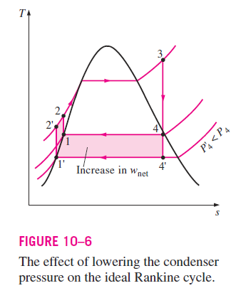
Lowering the Condenser Pressure (Lowers T_{low,avg})
Steam exists as a saturated mixture in the condenser at the saturation temperature corresponding to the pressure inside the condenser.
Therefore, lowering the operating pressure of the condenser automatically lowers the temperature of the steam, and thus the temperature at which heat is rejected.
The effect of lowering the condenser pressure on the Rankine cycle efficiency is illustrated on a T-s diagram in Fig. 10–6.

Slide 25
For comparison purposes, the turbine inlet state is maintained the same.
The colored area on this diagram represents the increase in net work output as a result of lowering the condenser pressure from P₄ to P’₄
The heat input requirements also increase (represented by the area under curve 2’-2), but this increase is very small.
Thus the overall effect of lowering the condenser pressure is an increase in the thermal efficiency of the cycle.

Slide 26
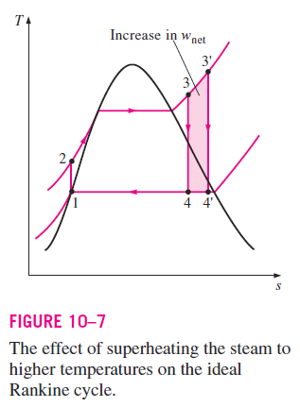
Superheating the Steam to High Temperatures (Increases T_{high,avg})
The average temperature at which heat is transferred to steam can be increased without increasing the boiler pressure by superheating the steam to high temperatures.
The effect of superheating on the performance of vapor power cycles is illustrated on a T-s diagram in Fig. 10–7.
The colored area on this diagram represents the increase in the net work.
The total area under the process curve 3-3 represents the increase in the heat input.

Slide 27
Thus both the net work and heat input increase as a result of superheating the steam to a higher temperature.
The overall effect is an increase in thermal efficiency, however, since the average temperature at which heat is added increases.
Superheating the steam to higher temperatures has another very desirable effect:
It decreases the moisture content of the steam at the turbine exit, as can be seen from the T-s diagram (the quality at state 4’ is higher than that at state 4).

Slide 28
The temperature to which steam can be superheated is limited, however, by metallurgical considerations.
Presently the highest steam temperature allowed at the turbine inlet is about 620°C (1150°F).
Any increase in this value depends on improving the present materials or finding new ones that can withstand higher temperatures.
Ceramics are very promising in this regard.

Slide 29
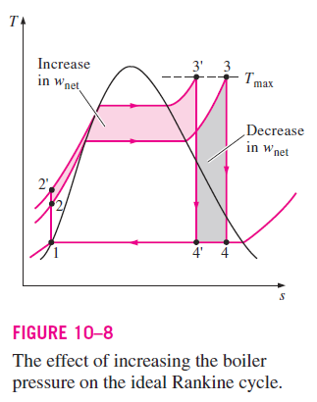
Increasing the Boiler Pressure (Increases T_{high,avg})
Another way of increasing the average temperature during the heat-addition process is to increase the operating pressure of the boiler, which automatically raises the temperature at which boiling takes place.
This, in turn, raises the average temperature at which heat is transferred to the steam and thus raises the thermal efficiency of the cycle.

Slide 30
The effect of increasing the boiler pressure on the performance of vapor power cycles is illustrated on a T-s diagram in Fig. 10–8.
Notice that for a fixed turbine inlet temperature, the cycle shifts to the left and the moisture content of steam at the turbine exit increases.
This undesirable side effect can be corrected, however, by reheating the steam, as discussed in the next section.

Slide 31
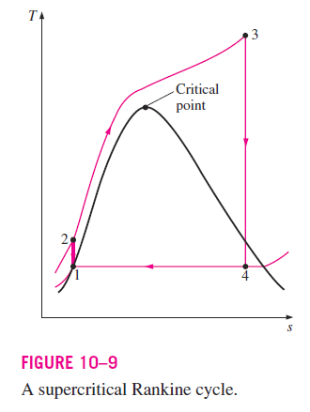
Operating pressures of boilers have gradually increased over the years from about 2.7 MPa (400 psia) in 1922 to over 30 MPa (4500 psia) today.
Today many modern steam power plants operate at supercritical pressures (P > 22.06 MPa) and have thermal efficiencies of about 40 percent for fossil-fuel plants.
The T-s diagram of a supercritical Rankine cycle is shown in Fig. 10–9.

Slide 32
THE IDEAL REHEAT RANKINE CYCLE
We noted in the last section that increasing the boiler pressure increases the thermal efficiency of the Rankine cycle, but it also increases the moisture content of the steam to unacceptable levels.
Then it is natural to ask the following question:
How can we take advantage of the increased efficiencies at higher boiler pressures without facing the problem of excessive moisture at the final stages of the turbine?

Slide 33
Two possibilities come to mind:
Superheat the steam to very high temperatures before it enters the turbine.
This would be the desirable solution since the average temperature at which heat is added would also increase, thus increasing the cycle efficiency.
This is not a viable solution, however, since it requires raising the steam temperature to metallurgically unsafe levels.
Expand the steam in the turbine in two stages and reheat it in between.
In other words, modify the simple ideal Rankine cycle with a reheat process.
Reheating is a practical solution to the excessive moisture problem in turbines, and it is commonly used in modern steam power plants.

Slide 34
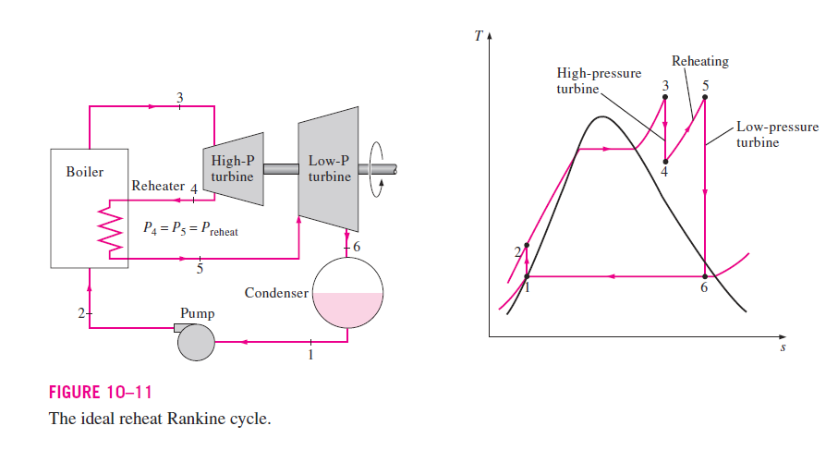
The T-s diagram of the ideal reheat Rankine cycle and the schematic of the power plant operating on this cycle are shown in Fig. 10–11.

Slide 35
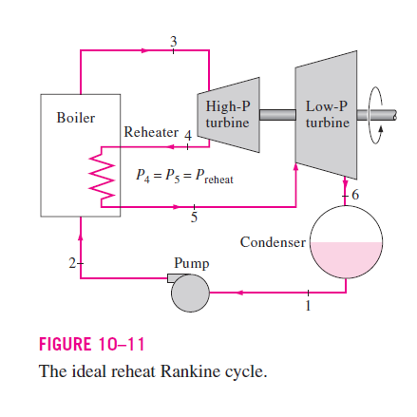
The ideal reheat Rankine cycle differs from the simple ideal Rankine cycle in that the expansion process takes place in two stages.
In the first stage (the high-pressure turbine), steam is expanded isentropically to an intermediate pressure and sent back to the boiler where it is reheated at constant pressure, usually to the inlet temperature of the first turbine stage.
Steam then expands isentropically in the second stage (low-pressure turbine) to the condenser pressure.

Slide 36
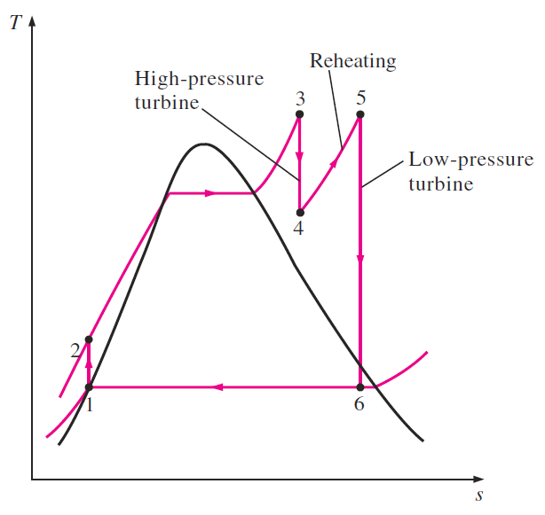
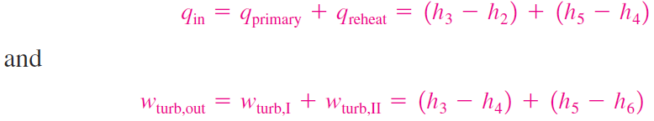
Thus the total heat input and the total turbine work output for a reheat cycle become
The incorporation of the single reheat in a modern power plant improves the cycle efficiency by 4 to 5 percent by increasing the average temperature at which heat is transferred to the steam.

Slide 37
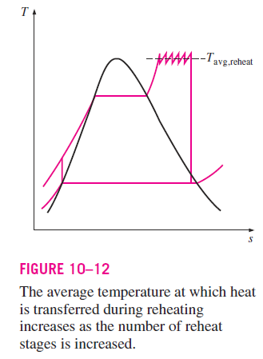
The average temperature during the reheat process can be increased by increasing the number of expansion and reheat stages.
As the number of stages is increased, the expansion and reheat processes approach an isothermal process at the maximum temperature, as shown in Fig. 10–12.
The use of more than two reheat stages, however, is not practical.
The theoretical improvement in efficiency from the second reheat is about half of that which results from a single reheat.
A third reheat stage would increase the cycle efficiency by about half of the improvement attained by the second reheat.
This gain is too small to justify the added cost and complexity.

Slide 38
The reheat cycle was introduced in the mid-1920s, but it was abandoned in the 1930s because of the operational difficulties.
The steady increase in boiler pressures over the years made it necessary to reintroduce single reheat in the late 1940s and double reheat in the early 1950s.

Slide 39
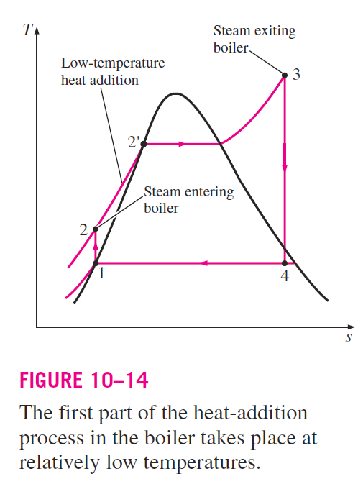
THE IDEAL REGENERATIVE RANKINE CYCLE
A careful examination of the T-s diagram of the Rankine cycle redrawn in Fig. 10–14 reveals that heat is transferred to the working fluid during process 2-2’ at a relatively low temperature.
This lowers the average heat addition temperature and thus the cycle efficiency.

Slide 40
To overcome this shortcoming, we look for ways to raise the temperature of the liquid leaving the pump (called the feedwater) before it enters the boiler.
One such possibility is to transfer heat to the feedwater from the expanding steam in a counterflow heat exchanger built into the turbine, that is, to use regeneration.
This solution is also impractical because it is difficult to design such a heat exchanger and because it would increase the moisture content of the steam at the final stages of the turbine.

Slide 41
A practical regeneration process in steam power plants is accomplished by extracting, or “bleeding,” steam from the turbine at various points.
This steam, which could have produced more work by expanding further in the turbine, is used to heat the feedwater instead.
The device where the feedwater is heated by regeneration is called a regenerator, or a feedwater heater (FWH).
Regeneration not only improves cycle efficiency, but also provides a convenient means of deaerating the feedwater (removing the air that leaks in at the condenser) to prevent corrosion in the boiler.
It also helps control the large volume flow rate of the steam at the final stages of the turbine (due to the large specific volumes at low pressures).
Therefore, regeneration has been used in all modern steam power plants since its introduction in the early 1920s.

Slide 42
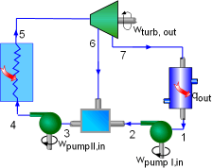
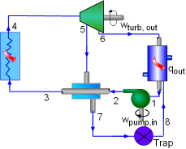
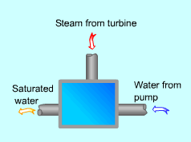
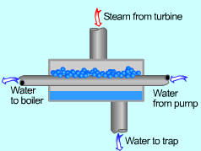
A feedwater heater is basically a heat exchanger where heat is transferred from the steam to the feedwater either by mixing the two fluid streams (open feedwater heaters) or without mixing them (closed feedwater heaters).
Schematic of a Power Plant Running an Ideal Regenerative Rankine Cycle with One Closed Feedwater Heater
open feedwater heaters
Schematic of a Power Plant Running an Ideal Regenerative Rankine Cycle with One Open Feedwater Heater
Closed feedwater heaters

Slide 43
Open Feedwater Heaters
An open (or direct-contact) feedwater heater is basically a mixing chamber, where the steam extracted from the turbine mixes with the feedwater exiting the pump.
Ideally, the mixture leaves the heater as a saturated liquid at the heater pressure.
The schematic of a steam power plant with one open feedwater heater (also called single-stage regenerative cycle) and the T-s diagram of the cycle are shown in Fig. 10–15.

Slide 44
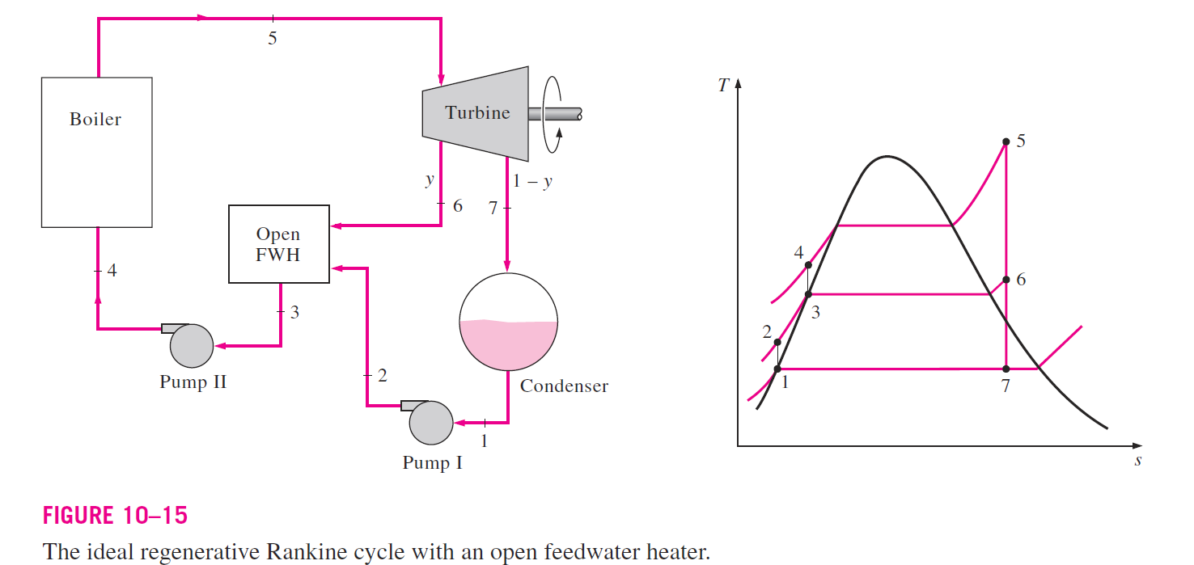
The schematic of a steam power plant with one open feedwater heater (also called single-stage regenerative cycle) and the T-s diagram of the cycle are shown in Fig. 10–15.

Slide 45
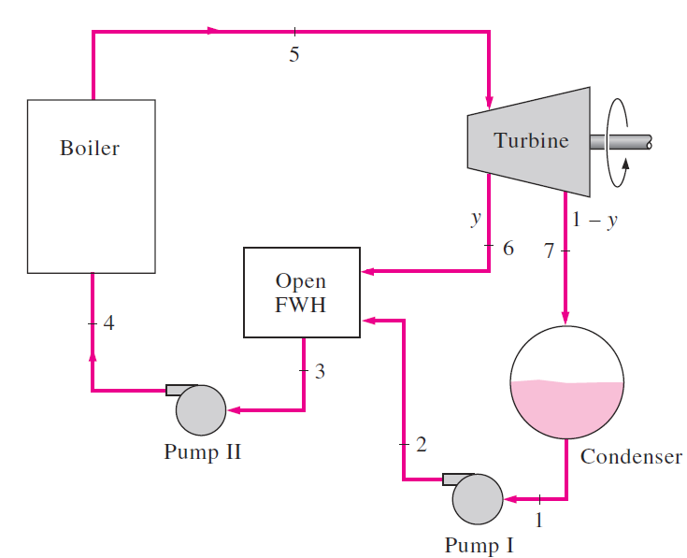
In an ideal regenerative Rankine cycle, steam enters the turbine at the boiler pressure (state 5) and expands isentropically to an intermediate pressure (state 6).
Some steam is extracted at this state and routed to the feedwater heater, while the remaining steam continues to expand isentropically to the condenser pressure (state 7).
This steam leaves the condenser as a saturated liquid at the condenser pressure (state 1).

Slide 46
The condensed water, which is also called the feedwater, then enters an isentropic pump, where it is compressed to the feedwater heater pressure (state 2) and is routed to the feedwater heater, where it mixes with the steam extracted from the turbine.
The fraction of the steam extracted is such that the mixture leaves the heater as a saturated liquid at the heater pressure (state 3).
A second pump raises the pressure of the water to the boiler pressure (state 4).
The cycle is completed by heating the water in the boiler to the turbine inlet state (state 5).

Slide 47
In the analysis of steam power plants, it is more convenient to work with quantities expressed per unit mass of the steam flowing through the boiler.
For each 1 kg of steam leaving the boiler, y kg expands partially in the turbine and is extracted at state 6.
The remaining (1 - y) kg expands completely to the condenser pressure.
Therefore, the mass flow rates are different in different components.

Slide 48
If the mass flow rate through the boiler is m. , for example, it is (1 - y)m. through the condenser.
This aspect of the regenerative Rankine cycle should be considered in the analysis of the cycle as well as in the interpretation of the areas on the T-s diagram.

Slide 49
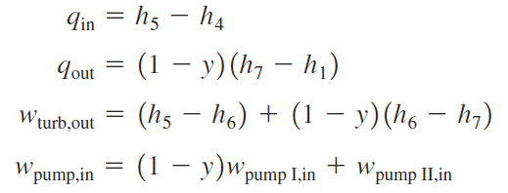
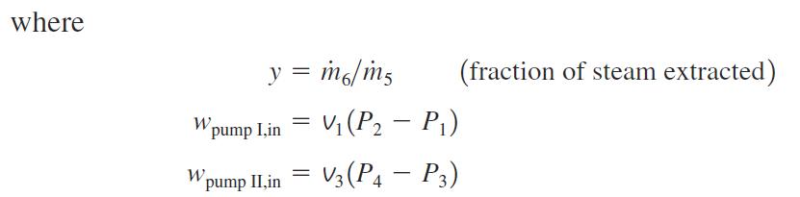
In light of Fig. 10–15, the heat and work interactions of a regenerative Rankine cycle with one feedwater heater can be expressed per unit mass of steam flowing through the boiler as follows:

Slide 50
The thermal efficiency of the Rankine cycle increases as a result of regeneration.
This is because regeneration raises the average temperature at which heat is transferred to the steam in the boiler by raising the temperature of the water before it enters the boiler.
The cycle efficiency increases further as the number of feedwater heaters is increased.
Many large plants in operation today use as many as eight feedwater heaters.
The optimum number of feedwater heaters is determined from economical considerations.
The use of an additional feedwater heater cannot be justified unless it saves more from the fuel costs than its own cost.

Slide 51
Closed Feedwater Heaters
Another type of feedwater heater frequently used in steam power plants is the closed feedwater heater, in which heat is transferred from the extracted steam to the feedwater without any mixing taking place.
Schematic of a Power Plant Running an Ideal Regenerative Rankine Cycle with One Closed Feedwater Heater
Closed feedwater heaters

Slide 52
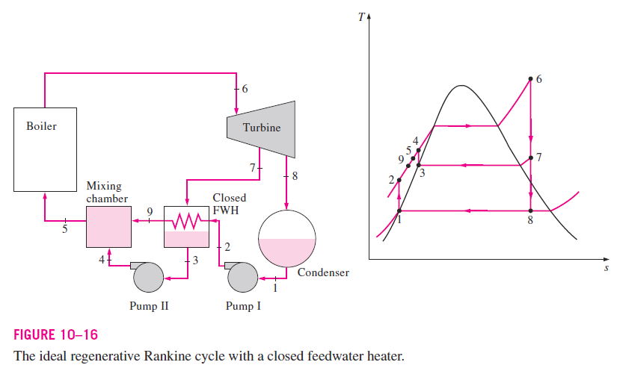
The two streams now can be at different pressures, since they do not mix.
The schematic of a steam power plant with one closed feedwater heater and the T-s diagram of the cycle are shown in Fig. 10–16.

Slide 53
In an ideal closed feedwater heater, the feedwater is heated to the exit temperature of the extracted steam, which ideally leaves the heater as a saturated liquid at the extraction pressure.
In actual power plants, the feedwater leaves the heater below the exit temperature of the extracted steam because a temperature difference of at least a few degrees is required for any effective heat transfer to take place.

Slide 54
The open and closed feedwater heaters can be compared as follows:
Open feedwater heaters are simple and inexpensive and have good heat transfer characteristics.
They also bring the feedwater to the saturation state.
For each heater, however, a pump is required to handle the feedwater.
The closed feedwater heaters are more complex because of the internal tubing network, and thus they are more expensive.
Heat transfer in closed feedwater heaters is also less effective since the two streams are not allowed to be in direct contact.
However, closed feedwater heaters do not require a separate pump for each heater since the extracted steam and the feedwater can be at different pressures.

